Slide 1

Predicting House Prices with Regression Model
By Maksat Bairamov

Slide 2

Introduction
Welcome, everyone! Today, I'll be presenting our project on "Predicting House Prices with Regression Models." Our primary goal is to build a model that accurately predicts house prices based on various features. Let's dive into the details!

Slide 3

Data Preparation
Before we begin modeling, let's have a quick overview of the data preparation steps:
  We used the "California Housing dataset" from scikit-learn.
  Conducted preliminary data analysis to understand the dataset.
  Handled missing values by filling them with feature means.

Slide 4
Model Selection
We selected the following regression models for our project:
Linear Regression
Random Forest
XGBoost
LASSO
These models offer diverse approaches to predicting house prices.

Slide 5
Model Training and Evaluation
Next, let's see how our models performed on the test dataset. Here are the performance metrics for each model:
Linear Regression:
  Mean Squared Error (MSE): 0.50
  Root Mean Squared Error (RMSE): 0.71
  Mean Absolute Error (MAE): 0.53
  R-squared (R2): 0.61
Random Forest:
  MSE: 0.24
  RMSE: 0.49
  MAE: 0.36
  R2: 0.80
XGBoost:
  MSE: 0.22
  RMSE: 0.47
  MAE: 0.36
  R2: 0.82
LASSO:
  MSE: 0.63
  RMSE: 0.79
  MAE: 0.58
  R2: 0.46

Slide 6
Results Visualization
Let's take a visual look at how our models performed:
Scatter plots comparing actual and predicted house prices for each model.
Feature importance plots revealing the significant impact of different features on house prices.

Slide 7
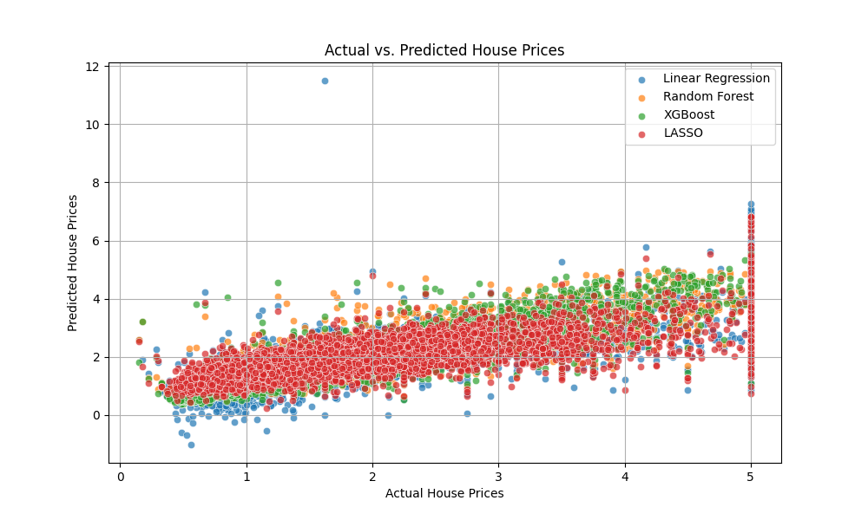
Figure 1​

Slide 8
Discussion of Results
Based on our analysis, the best-performing model is XGBoost. It achieved the lowest RMSE and the highest R-squared score, indicating better predictive performance.

Slide 9
Conclusions
In conclusion, our project successfully developed regression models to predict house prices. XGBoost demonstrated superior performance, and key features were identified. This project offers valuable insights for real estate professionals and potential home buyers.

Slide 10
Future Possibilities
Future improvements may include:
Exploring more hyperparameter combinations to enhance model performance.
Adopting advanced data imputation techniques to handle missing data more effectively.

Slide 11
Thank You for Attention
Presentation was made by Maksat Bairamov

